Slide 1
COMP 7212: Operating/Distributed Systems
Chapter 3: Processes
Dr. Myounggyu Won
“Processes play a fundamental role in distributed systems. They form a basis for
communication between different machines”.
Reference: Distributed Systems: Principles and Paradigms (3rd Edition)

Slide 2
Overview
Threads
  Introduction to threads
  Threads in distributed systems
Virtualization
  Principle of virtualization
  Application of virtualization
Clients (Client Processes)
  Networked user interfaces
  Client-side software for distribution transparency
Servers (Server Processes)
  Design issues
  Object servers

Slide 3
Threads

Slide 4
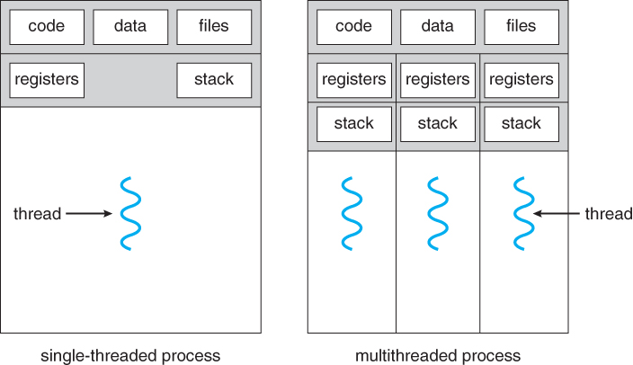
Introduction to Threads (1/4)
Process: a program in execution; an independent address space is created
A thread is a basic unit of CPU utilization.
It comprises a thread ID, a program counter, a register set, and a stack.
It shares with other threads belonging to the same process its code section, data section, and other operating-system resources, such as open files.
  Programmer’s job to divide the code into code blocks that are executed by each thread

Slide 5
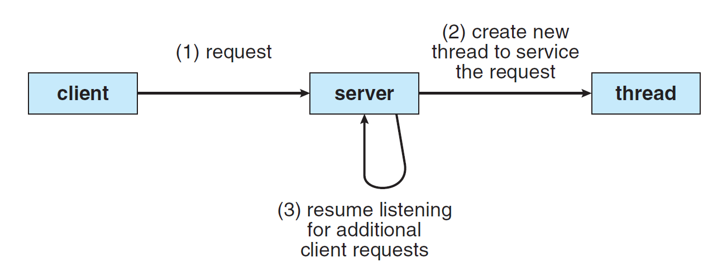
Introduction to Threads (2/4)
Most applications are multi threaded.
Most OS kernels are multi threaded.
e.g.,
  web browser
    Display image; retrieves data from the network.
  Word processor
    Display graphics; read user keystrokes; check grammar.
Multi threaded server architecture

Slide 6
Introduction to Threads (3/4)
Benefits
  Responsiveness: a program continues to execute even if a part of it is blocked (e.g., I/O operation).
    Useful for user interface design.
  Resource Sharing: threads share the code, data, and OS resources.
    Processes share resources via inter-process communication (overhead & programming burden)
  Economy: lightweight to create threads since they share resources.
  Scalability: threads may be running in parallel on different processing cores.
    A single threaded process can run on a single CPU.

Slide 7
Introduction to Threads (4/4)
Having a finer granularity in the form of multiple threads per process makes it easier to build a distributed applications and achieve better performance.
  By breaking a process into multiple threads, it is more flexible to manage; responsiveness is improved; and CPU utilization is improved.

Slide 8
Thread Implementation (1/4)
Two approaches of creating threads
  Use a user-level library to create a thread
    The operating system is not aware of the presence of these threads.
    Advantages
      Speed
      Control
      Efficiency (i.e., kernel is not involved)
    Disadvantages
      Blocking issue
      No kernel-level prioritization (Since kernel is not involved, no optimization for scheduling is applied).

Slide 9
Thread Implementation (2/4)
Two approaches of creating threads cont.
  Use the system calls of kernel to create threads
  Advantages
    Concurrency – true concurrency is achieved. For user-level threads, “simulated” concurrency is used.
    Better Integration with Kernel – Advanced scheduling techniques can be applied
    Robustness – no blocking issue
  Disadvantages
    Overhead – subject to resource-intensive context switches
    Complexity – More complex to implement and harder to debug

Slide 10
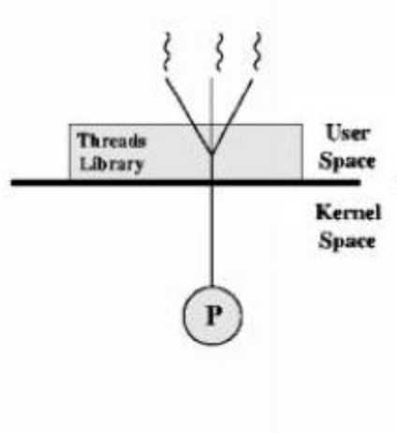
Thread Implementation (3/4)
User-level thread library
  Cheap to create and destroy threads
    All thread administration is kept in the user space
  Switching threads can be done in just a few instructions
  However, since multiple threads are mapped to a single schedulable entity (many-to-one threading model), the invocation of a blocking system call will block the entire process to which the threads belong.

Slide 11
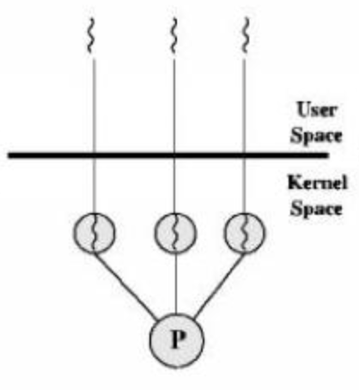
Thread Implementation (4/4)
Implementing threading in the operating system’s kernel (one-to-one threading model)
  Every thread is a schedulable entity.
  Every thread operation (creation, deletion, synchronization, etc.) has to be done by the kernel, requiring a system call.
  The blocking thread problem is addressed; however, the cost of running a thread is more expensive.

Slide 12
Threads in Distributed Systems (1/3)
An important property of threads (one-to-one or many-to-many mapping) is that they allow blocking system calls without blocking the entire process.
  A blocking system call is a function that causes the calling process (or thread) to be suspended until the event associated with the system call completes.
  Makes it much easier for a node to maintain multiple logical connections with other nodes at the same time.
    Each connection is managed by a separate thread.

Slide 13
Threads in Distributed Systems (2/3)
Example: Multithreaded clients
  In many distributed systems, we need to conceal long inter-process message propagation delay
  One way to conceal the propagation delay is to initiate communication (managed by a separate thread) and immediately proceed with something else
    A web browser displaying data while data is coming
    Several connections can be opened simultaneously with replicated servers.

Slide 14
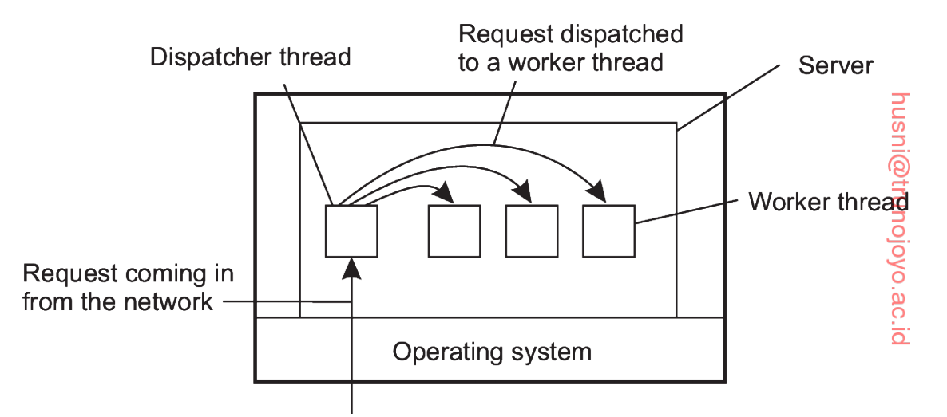
Threads in Distributed Systems (3/3)
Example: Multithreaded servers
  The main use of multithreads is usually found at the server side.
  Consider a file server as an example
    Waits for an incoming request for a file operation
    Carries out the request using a separate thread (worker thread)
    Sends back the reply

Slide 15
Virtualization
A key to running processes on heterogeneous nodes

Slide 16
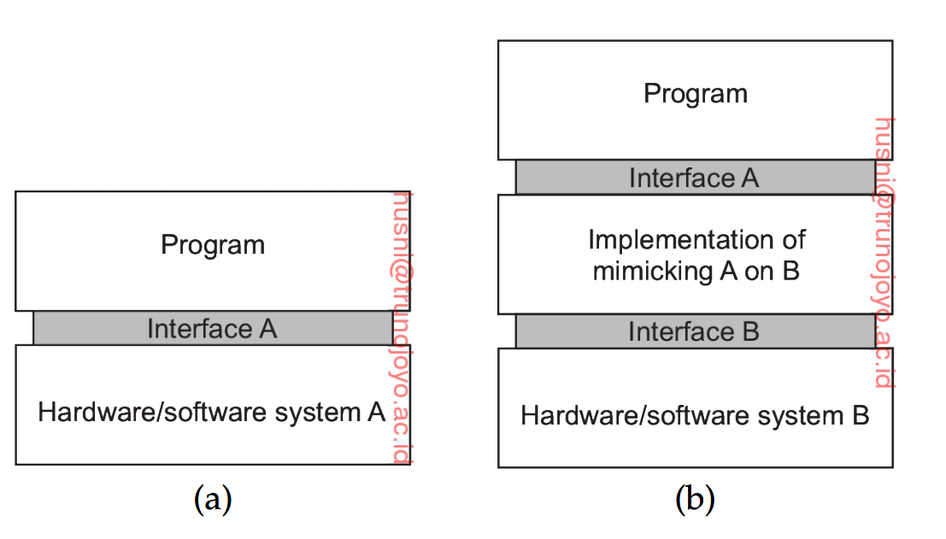
Principles of Virtualization (1/2)
Virtualization deals with extending or replacing an existing interface so as to mimic the behavior of another system.
A virtualization layer that replaces the original
interface B with the new one A to allow for access
to the hardware with the new interface.
e.g., basic instruction set,
programming API, designed to access
Hardware system A

Slide 17
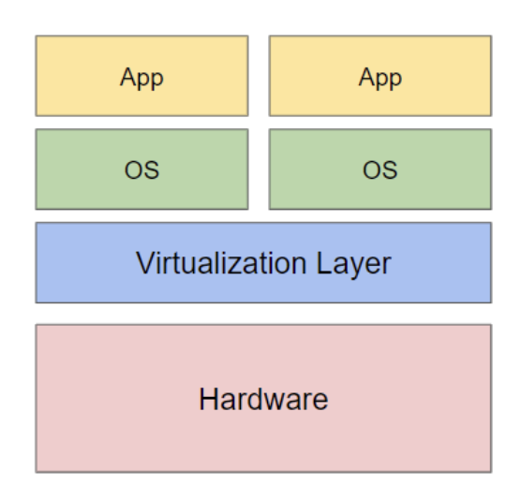
Principles of Virtualization (2/2)
One of the most important reasons for using virtualization in 1970s was to run legacy software on expensive mainframe hardware
  A virtualized interface to allow legacy software to run on the new hardware platform.
  Provides a high degree of portability and flexibility.
  Support for easier replication of content on heterogeneous platforms
Legacy
Legacy
New

Slide 18
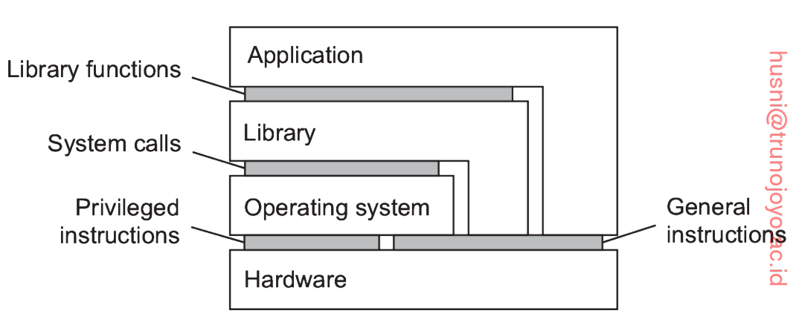
Types of Virtualization
There are many different ways in which virtualization can be realized.
To understand the different types of virtualization, it is important to understand first that computer systems generally offer four different types of interfaces, at three different levels
for OS only
for users and OS

Slide 19
Process Virtual Machine
A type of virtual machine (VM) that provides a virtualized execution environment for a single program/process.
  Virtualizes all layers
This abstraction allows a process to run on any underlying hardware or operating system that supports the VM, without needing modification.
Examples
  Java Virtual Machine (JVM)
    The JVM allows Java programs to run on any device and any OS that have a JVM installed.
  .NET Framework Common Language Runtime (CLR)
    Similar to JVM

Slide 20
Hosted Virtual Machine Monitor (1/2)
A type 2 hypervisor that replaces the interface of an existing host operating system (OS) to manage and run guest operating systems.
  Virtualizes the system call interface
  Virtualizes the general hardware interface
Examples
  VMWare Workstation
  Oracle VM VirtualBox

Slide 21
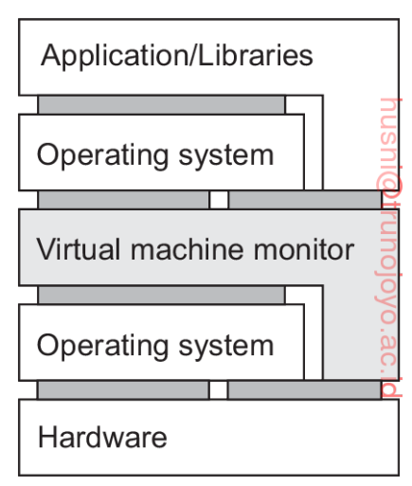
Hosted Virtual Machine Monitor (2/2)
Type 2 Hypervisor
  Virtualizes the system call interface and general hardware interface.
    A system call interface A of operating system A is replaced with a new system call interface B with a new operating system.
      Basically, providing a new OS platform to user applications.
    Also, a general hardware interface A for Hardware A can be replaced with a new hardware interface B.

Slide 22
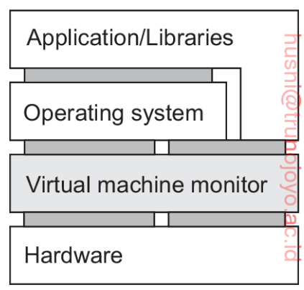
Native Virtual Machine Monitor
  Type 1 Hypervisor
    Directly virtualizes the hardware interface
      No need the support of a host OS
    It is called native because it is directly implemented on top of the underlying hardware
    It is possible to have multiple guest operating systems run independently and concurrently on the same platform.
    Examples
      VMWare ESXi
      Microsoft Hyper-V

Slide 23
Applications of Virtualization for Distributed Systems
One of the most widely adopted applications of virtualization is for cloud computing
One of the most important services provided by cloud computing systems is
  Infrastructure-as-a-Service (IaaS)
    Instead of renting out a physical machine, a cloud provider rents out a virtual machine
      Thanks to the virtualization of the hardware interface, regardless of the different hardware/OS platform, the cloud user can access the system with a uniform interface.

Slide 24
Clients

Slide 25
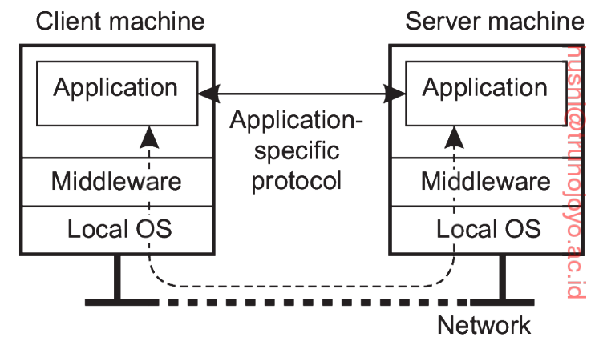
Networked User Interfaces (1/2)
A major task of client machines is to provide the means for users to interact with remote servers
Two ways for implementing interactions with servers
  A client has a separate counterpart for each remote service
    A separate application with its own functions, data, etc. corresponding to each service provided by the server.
    An application-specific communication protocol is used to communicate with the server.

Slide 26
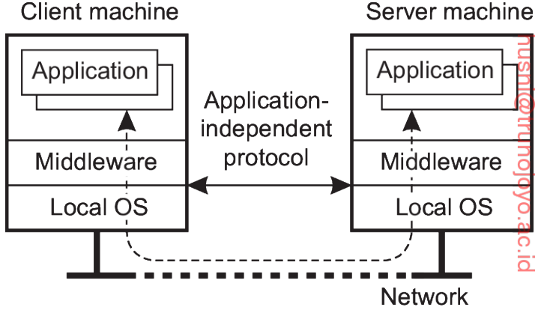
Networked User Interfaces (2/2)
  A client is offered with only a user interface for each service
    Most of the data (functions, data, etc.) are stored and processed at the server
    Called as networked user interfaces or thin-client approach
    A practical example is the Google’s Chrome OS. It is a browser-based thin client, where most computation is done at the server side.
A generic communication protocol works with many different applications because it transfers generic user-interface information rather than application-specific commands or data.

Slide 27
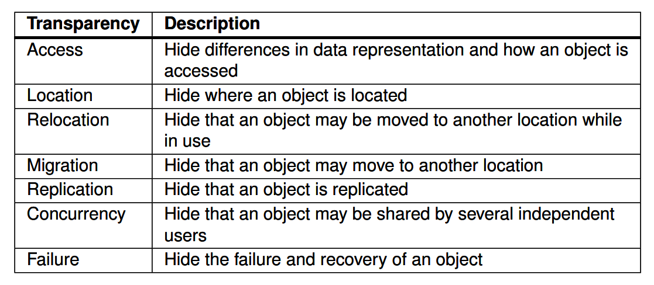
Client-side Software for Distribution Transparency (1/4)
How does the client achieve distribution transparency.
  Recall distribution transparency

Slide 28
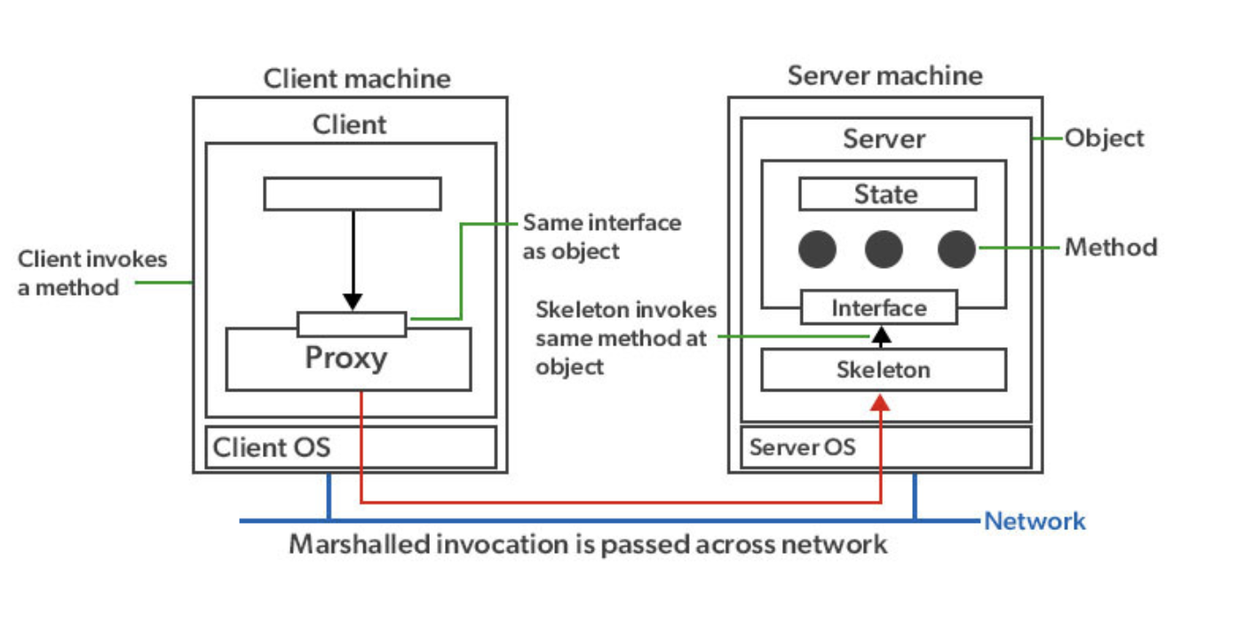
Client-side Software for Distribution Transparency (2/4)
Access transparency is generally handled through the generation of a client stub (Proxy)
  Proxy: A piece of code that acts as an intermediary for requests from clients seeking resources from other servers (Skeleton for servers).
    Provides the same interface but hides the differences in machine architectures as well as actual communication
    Transforms local calls to messages sent to the server
    Transforms messages from the server to return values

Slide 29
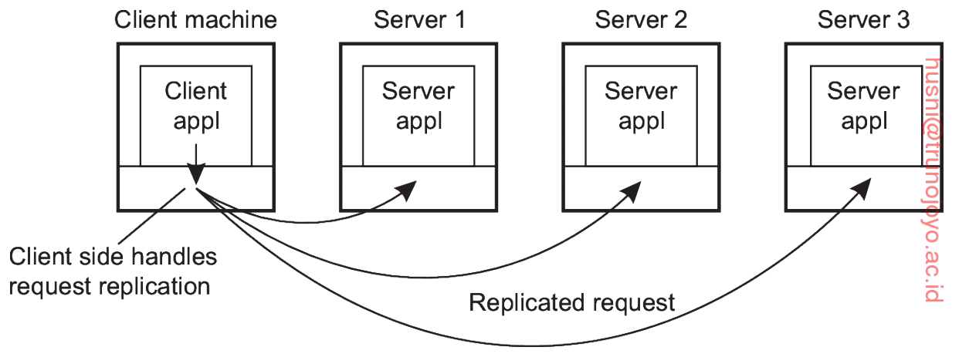
Client-side Software for Distribution Transparency (2/3)
Location, migration, and relocation transparency
  The client’s middleware hides the server’s current network location from the user
  Transparently rebinds to a new server, if necessary
Replication transparency
  Consider a system with replicated servers
  The client-side middleware (wrapper) forwards a request to each replica (See Figure below)
  The client-side middleware transparently collects all responses and passes a single response to the client application
Wrapper:

Slide 30
Client-side Software for Distribution Transparency (3/3)
Failure transparency
  Masking communication failures with a server is typically done through the client middleware
    Automatic retransmission
    Hiding delay (e.g., using cached data for a frequent request)
Concurrency transparency
  Concurrency transparency can be handled through transaction monitors.
    A transaction monitor is middleware for managing transactions across multiple software and hardware components.
      Implements various concurrency control mechanisms such as locking and timestamp ordering.

Slide 31
Servers

Slide 32
General Design Issues (1/4)
A server is a process implementing a specific service on behalf of a collection of clients
Each server operates in the similar way
  Waits for an incoming request from a client
  Processes the client request
  Waits for the next incoming request

Slide 33
General Design Issues (2/4)
Concurrent vs iterative servers
  An iterative server handles the request and returns a response to the requesting client, one after another.
    Locked while dealing with a request from a client
    A single-threaded server
  A concurrent server does not handle request itself but passes it to a separate thread or another process, after which it immediately waits for the next incoming message.
    A multi-threaded server

Slide 34
General Design Issues (3/4)
Contacting a server via the end points (ports)
  Where do clients contact a server?
  Clients send request to an end point (also called as port) at the machine where the server is running
  Each server listens to a specific end point
  How do clients know the end point of a service?
    Globally assign end points for well-known services (e.g., for FTP service, a server listens to port 21)
    These port numbers are assigned by the Internet Assigned Numbers Authority (IANA)

Slide 35
General Design Issues (4/4)
Contacting a server via the end points (cont.)
  Some services do not require pre-assigned end points
    e.g., a time-of-day server uses a dynamically assigned port number by its local OS
    Thus, a client will first have to look up the end point.
    Use a daemon server which responses with a port number (Fig (a))
  Keeping a server (e.g., a time-of-day server) running may be a waste of resources
    A single superserver listens to each end point and forks a server process when a request is received for a specific port number (Fig (b))

Slide 36
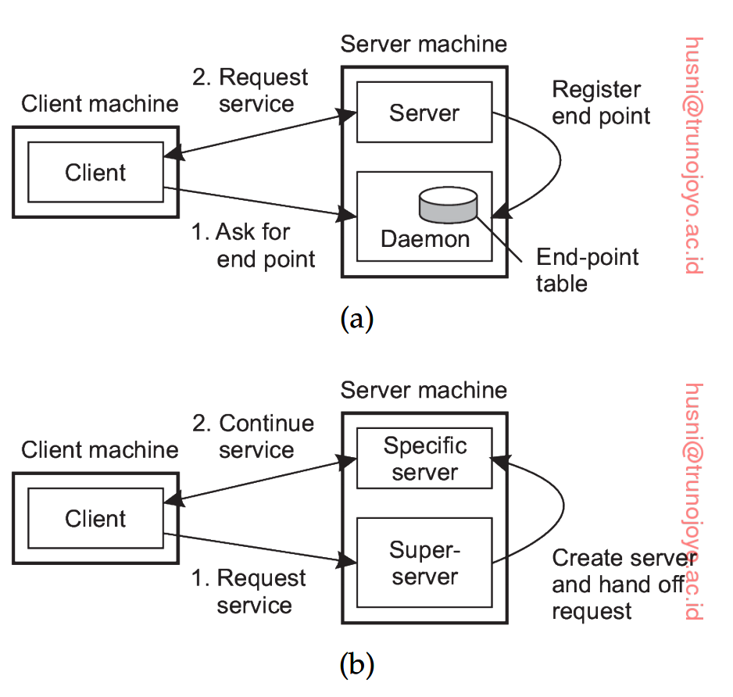

Slide 37
Interrupting a Server
An issue is whether and how a server can be interrupted (i.e., how and when the connection between client server is terminated).
  e.g., an FTP server where a user uploads a big file and decides to cancel it
Approach 1: abruptly exit the client application – the server will tear down the connection assuming that the client has crashed (or the client has finished its operation such as a file transfer)
  Is the client really crashed (or finished with its operation)? What if it was a temporary network issue?
Approach 2: A better approach is to allow to send out-of-band data which is processed before any other data from the client; a server listens to a separate end point where out-of-band data is received to terminate connection

Slide 38
Stateless vs Stateful Servers
A stateless server does not keep information on the state of its clients
  e.g., a web server simply responses to incoming HTTP requests (without maintaining any state about clients)
  Soft state: the server maintains the state only for a limited time
    e.g., to inform a client of an update for a limited time
A stateful server maintains persistent information on its clients
  e.g., a file server keeps track of which client has the update permission on which file
  A drawback is to recover the sate when the server crashes

Slide 39
Object Servers
In contrast to other traditional servers, an object server by itself does not provide a specific service
  Specific services are implemented by the objects that reside in the object server
  The object server provides only the means to invoke local objects based on requests from remote clients
  Easy to change services by simply adding or removing objects

